Slide 1
Summer Olympics Medals (1976-2008)
Variables used in from the dataset from the original
Year – Year in which the Summer Olympic games were held.
Gender – Men or Female
Discipline – Discipline within the sport such as diving, swimming
Country – Place of origin of the winning athlete belonging to.
After formatting dataset (shown in written code )
Gold Medal – Total gold medal won by each country
Silver Medal – Total silver medal won by each country
Bronze Medal – Total Bronze medal won by each country
Total Medal – Total Medal won by each country
Notes:
Variable used for analysis from two datasets. One from original and another from the first one to filter medal counts from each countries.

Slide 2
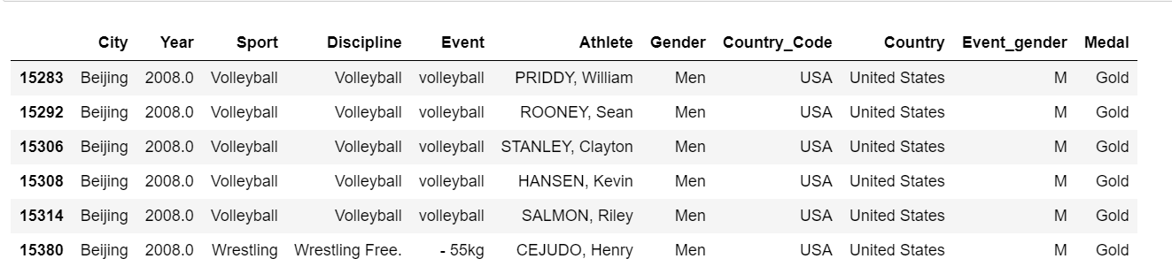
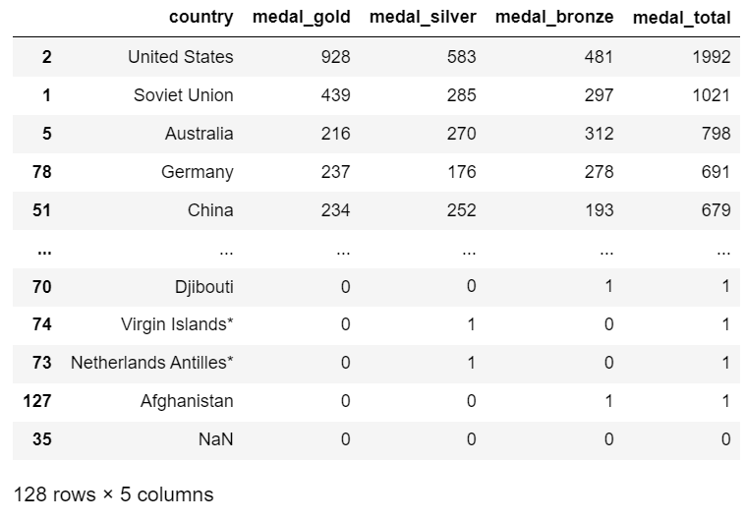
Glimpse Of Datasets
Notes:
Two datasets for the analysis. First has city, year, sport and so on and another has medal counts of each individual country.
Second dataset was created from the first dataset(filtered)

Slide 3
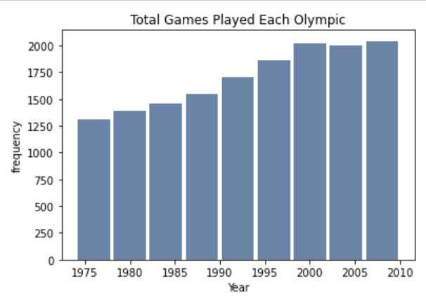
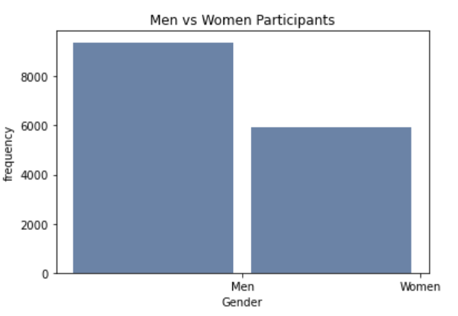
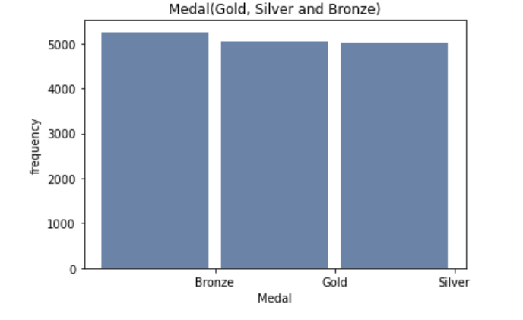
Histogram of variables chosen
Notes:
Histogram of Total Games Player Each Olympic event, total Men vs Women participants and Medal count( Gold, Silver and Bronze)- there is a difference in total of medal because some events were eliminated from the summer Olympic.

Slide 4
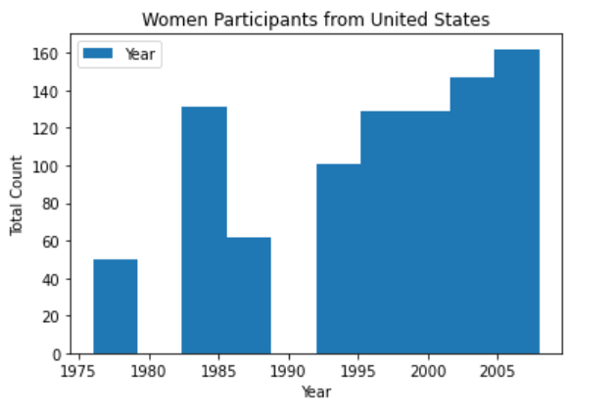
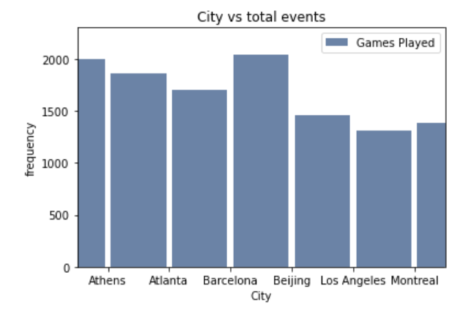
Histogram of variables chosen
Notes:
Histogram of Women participants from United States from year 1976 till 2008. and
Histogram of City vs total events from 1976 till 2008 of Summer Olympics.

Slide 5
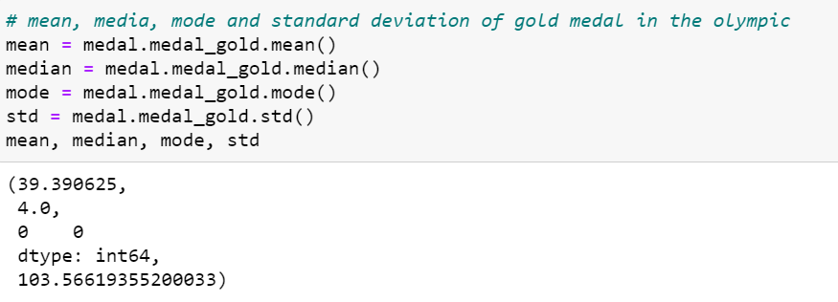
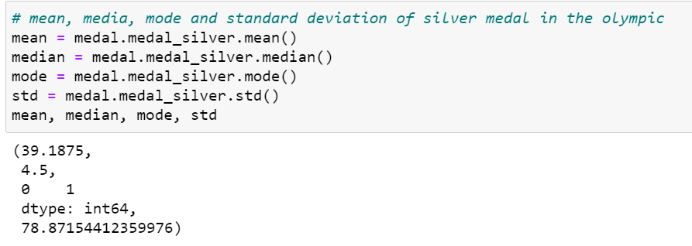
Descriptive Statistics
Notes:
Descriptive statistics of mean, median, mode, standard deviation of gold and silver medal in Summer Olympics

Slide 6
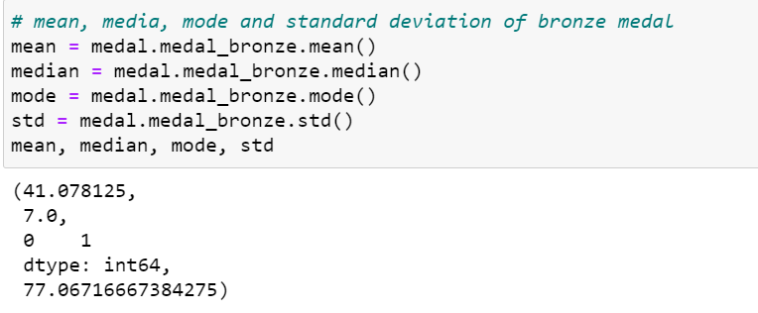
Descriptive Statistics
Notes:
Descriptive statistics of mean, median, mode, standard deviation of bronze medal in Summer Olympics.

Slide 7
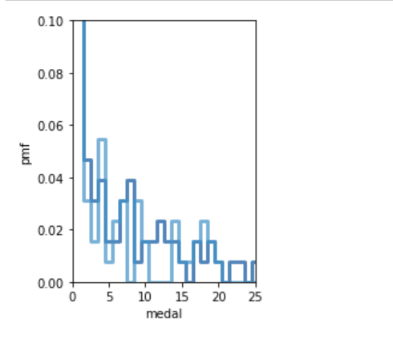
PMF of bronze and gold medal
Notes:
Two variable taken in this graph are from bronze medal and gold medal total.

Slide 8
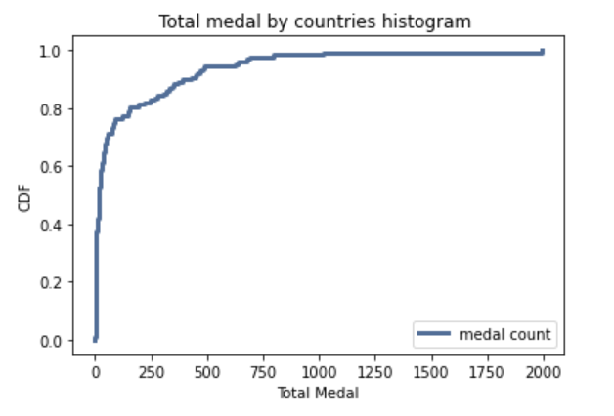
CDF of total medal variable
Notes:
The graph shows that fewer countries had total medal count of 1500 and above. Many of the countries total medal count fall
Between 0 to around 250 total medal count. This data represents from 1976 to 2008 summer Olympic.

Slide 9
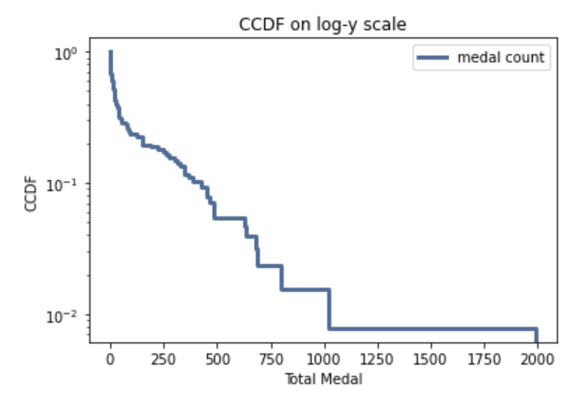
Analytic distribution – complementary cumulative distribution function
Notes:
Analytic Distribution from cdf of total medal count. Its not linear meaning that the medal count doesn’t match with exponential distribution.

Slide 10
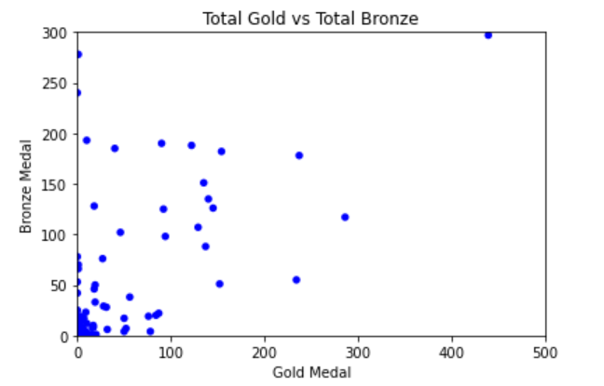
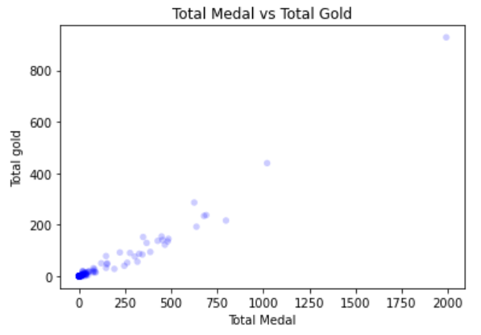
Scatter Plots for two variables
Notes:
As above graph shows for both, countries with higher gold is more likely to have higher medal
And countries with higher bronze medal are likely to have higher gold medal.

Slide 11
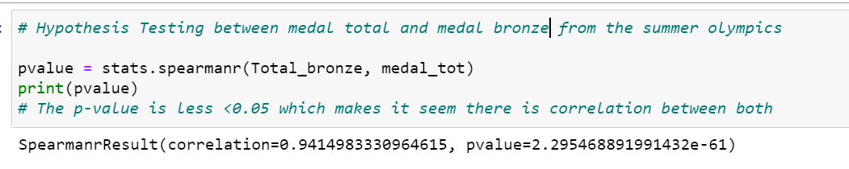
Hypothesis Testing
Notes:
There is the p-value which is less than 0.05 i.e high correlation between both total medal and bronze medal won.

Slide 12
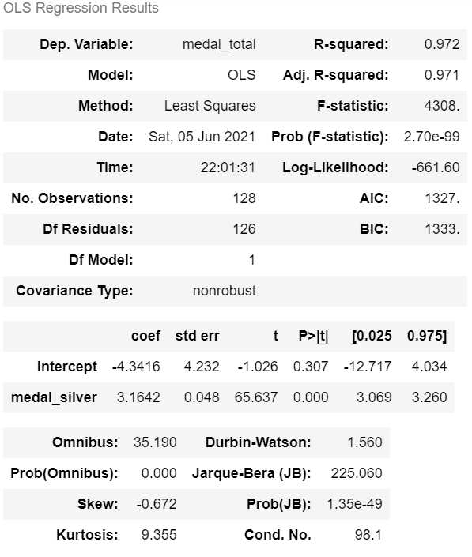
Regression Analysis
Notes:
As we can see above is regression analysis on total medal and total silver. Based on above result, it shows that there is high correlation between both the variables.

